Slide 1
Spreadsheet Submit Plugin
Isabel M. Pötzsch

Slide 2
Objective
Not all wet lab biologists know how to use SBOL
Simplify workflows
Increase the user friendliness of SynBioHub
Spreadsheets are easy to use and already part of the workflow in many labs

Slide 3



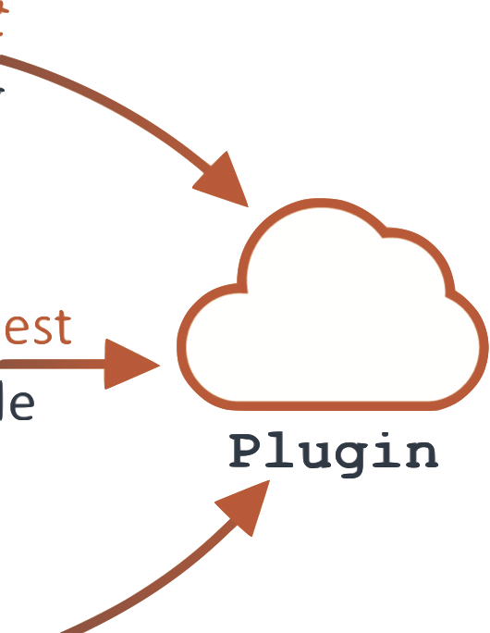

Concept
User
Mante, J., Zundel, Z. & Myers, C. Extending SynBioHub’s Functionality with Plugins. ACS Synth. Biol. 9, 1216–1220 (2020).
https://www.office.com
https://www.python.org
https://synbiohub.org/logo_uploaded.svg
https://raw.githubusercontent.com/SynBioDex/pySBOL2/master/logo.jpg
Isabel M. Pötzsch
Notes:
Explain endpoints

Slide 4
The Plugins in Tandem
User
Library
for Libraries
Composites
Parts
Composites
for Composites
Mante, J., Zundel, Z. & Myers, C. Extending SynBioHub’s Functionality with Plugins. ACS Synth. Biol. 9, 1216–1220 (2020).
https://www.office.com
https://www.python.org
https://synbiohub.org/logo_uploaded.svg
https://raw.githubusercontent.com/SynBioDex/pySBOL2/master/logo.jpg
Isabel M. Pötzsch
Notes:
You might also want to start with one slide between how the plugins work and the library/composite parts slide which indicate how the two plugins work in work flows together (the idea of upload parts to synbiohub and then list them in a composite spreadsheet).

Slide 5
The Code
Reading in of template and filled spreadsheet
Extensive quality checking and comparing
Extracting information from filled spreadsheet
Compiling sbol

Slide 6
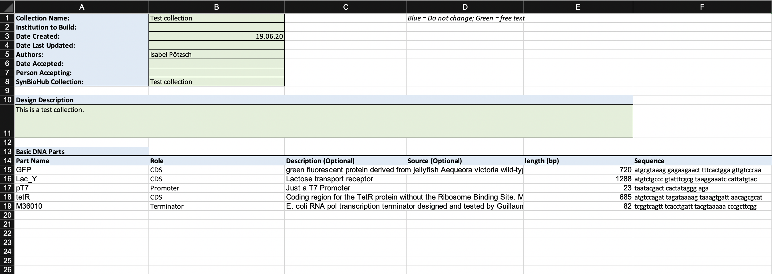
Library Template

Slide 7
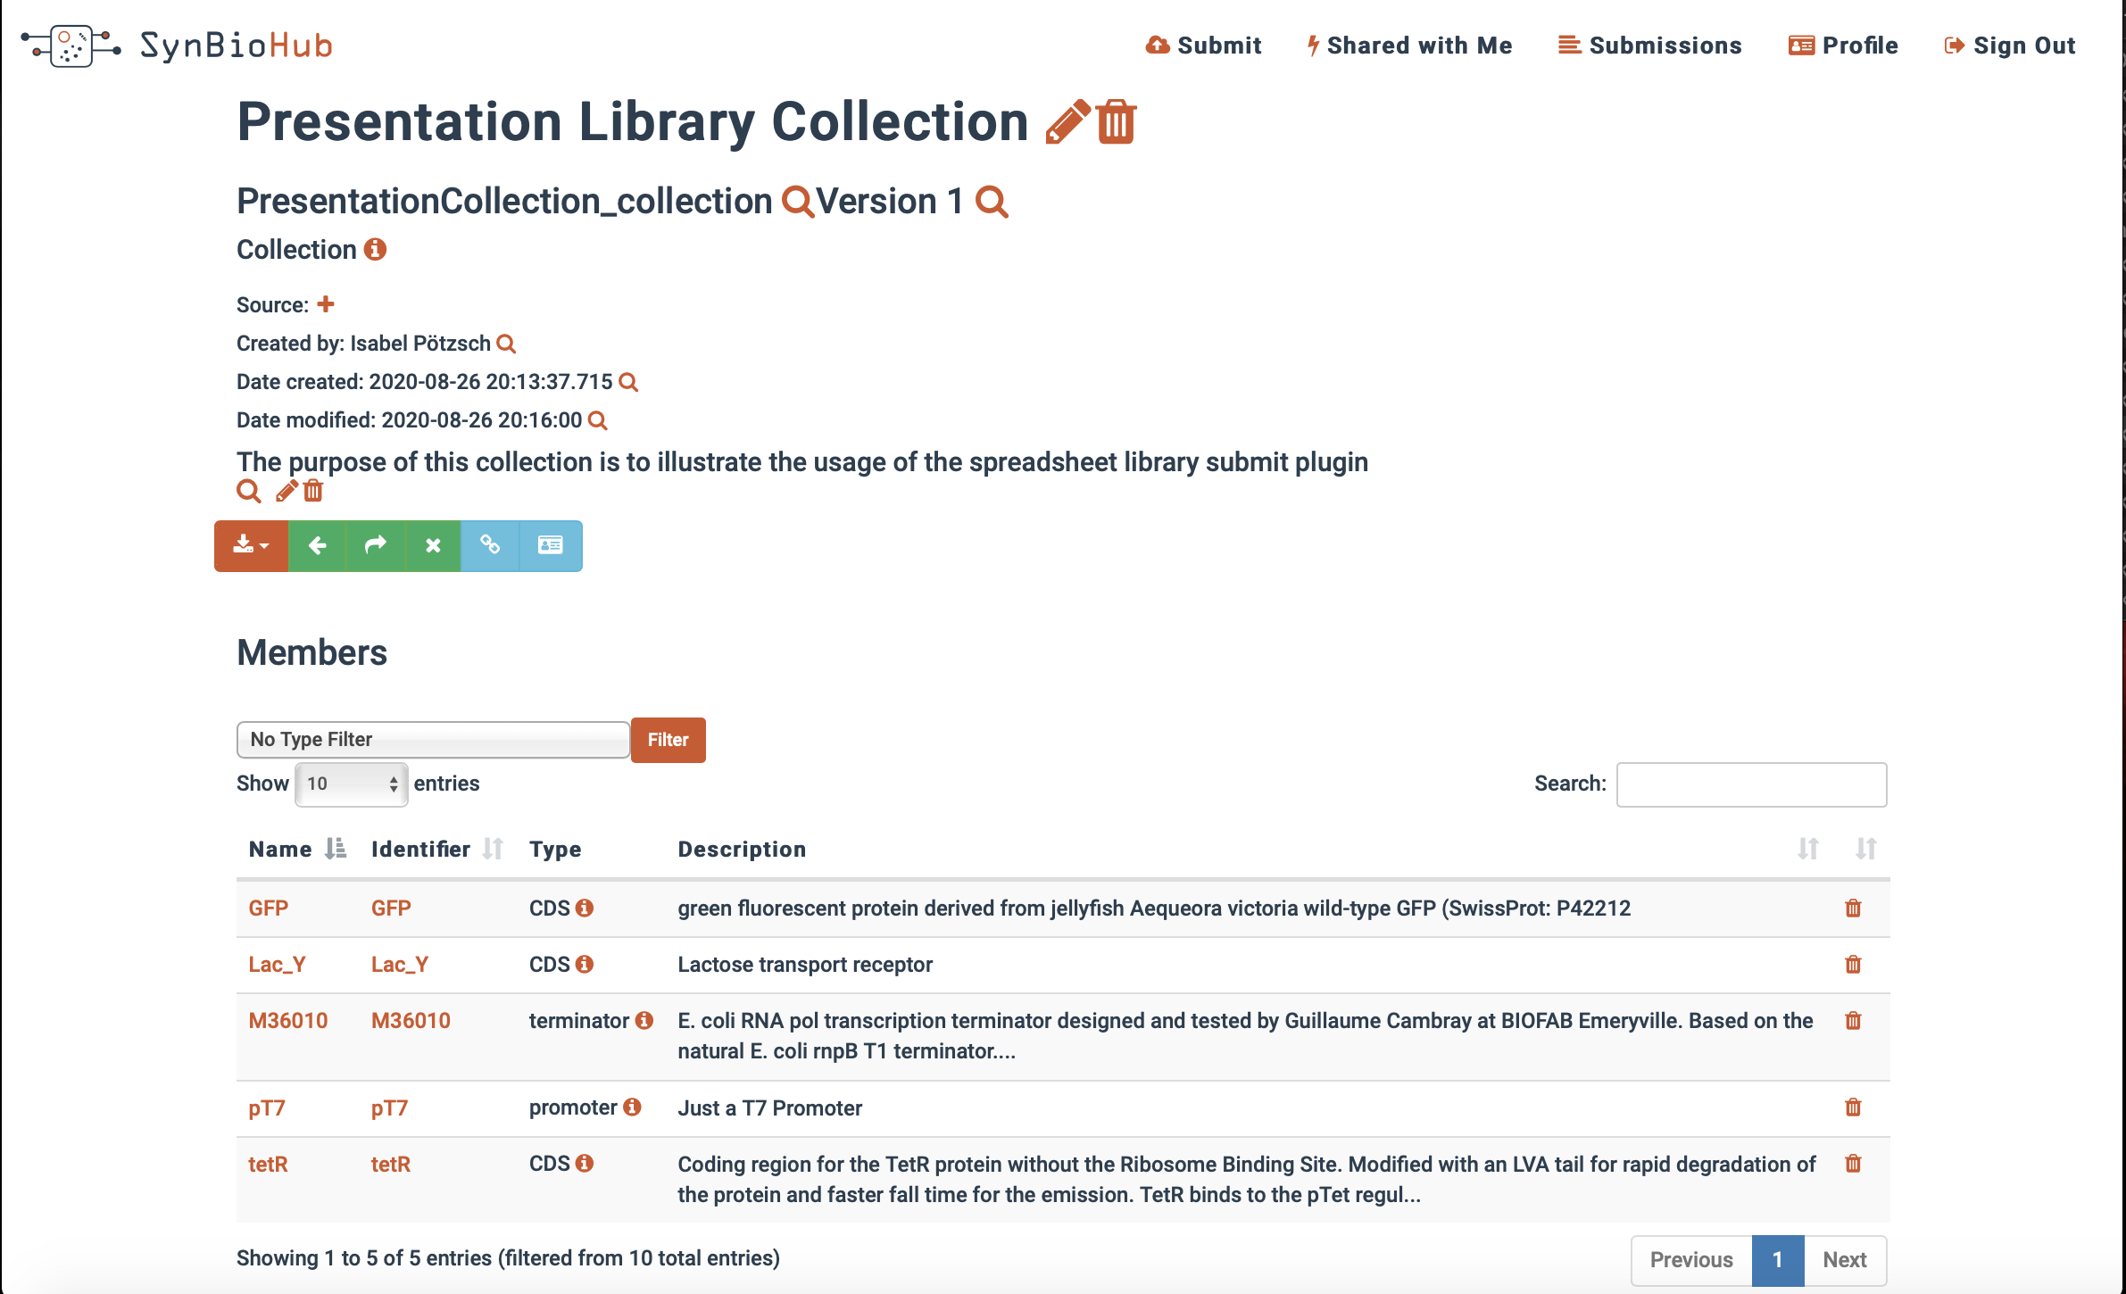
Library submission

Slide 8
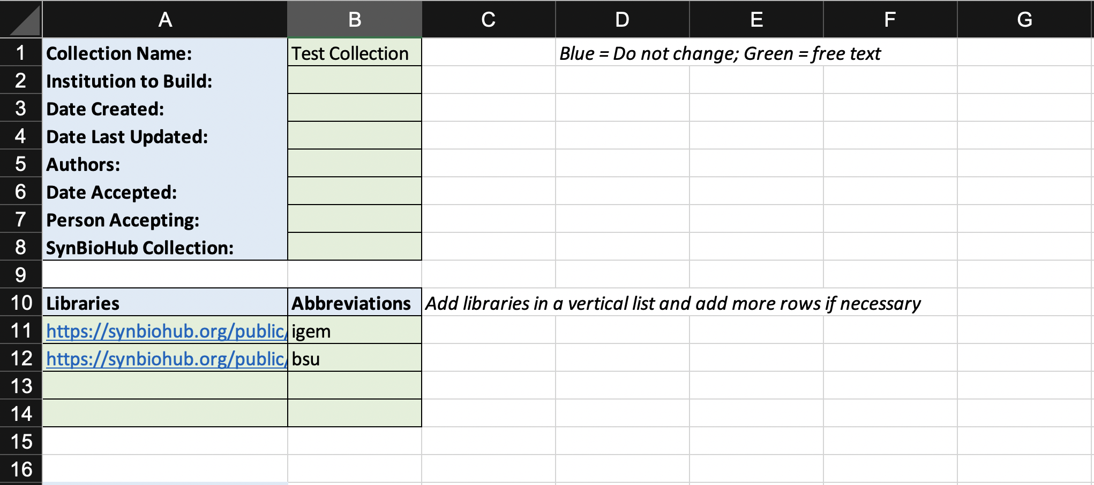
Composite Template – First Half

Slide 9
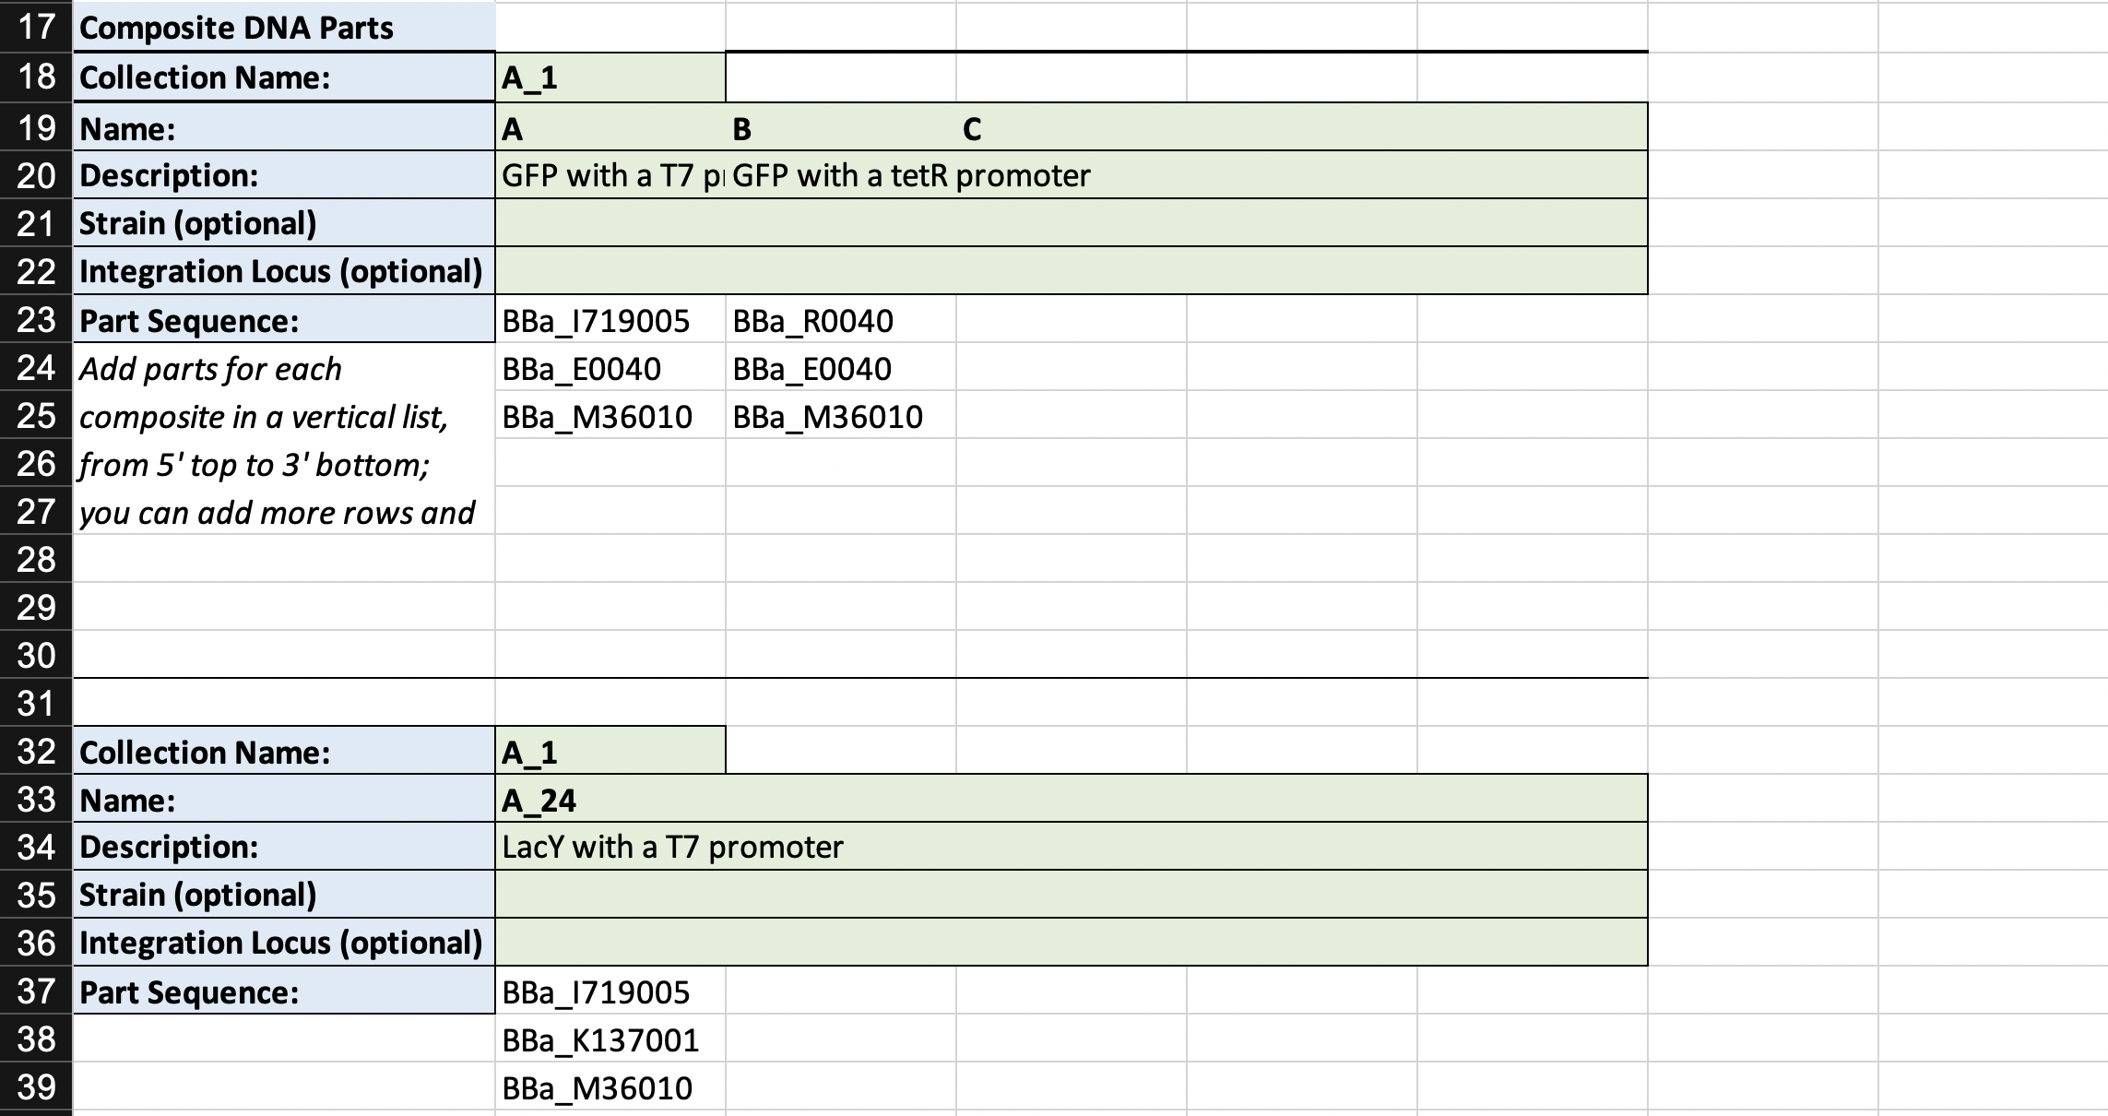
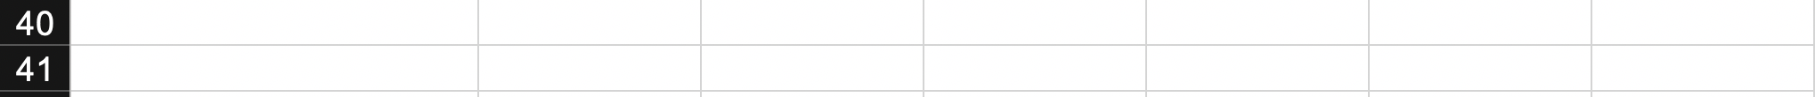
Composite Template – Second half
Notes:
You could also talk a little bit about the difficulty of the variable row lengths and number of columns used.
I think you could focus on the error checks you put in, names changing, multiple collections, etc.

Slide 10
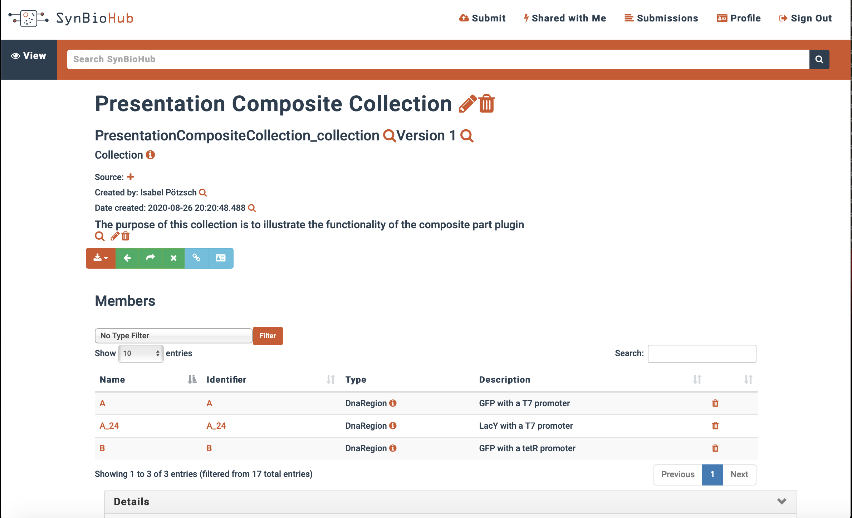
Composite Submission

Slide 11
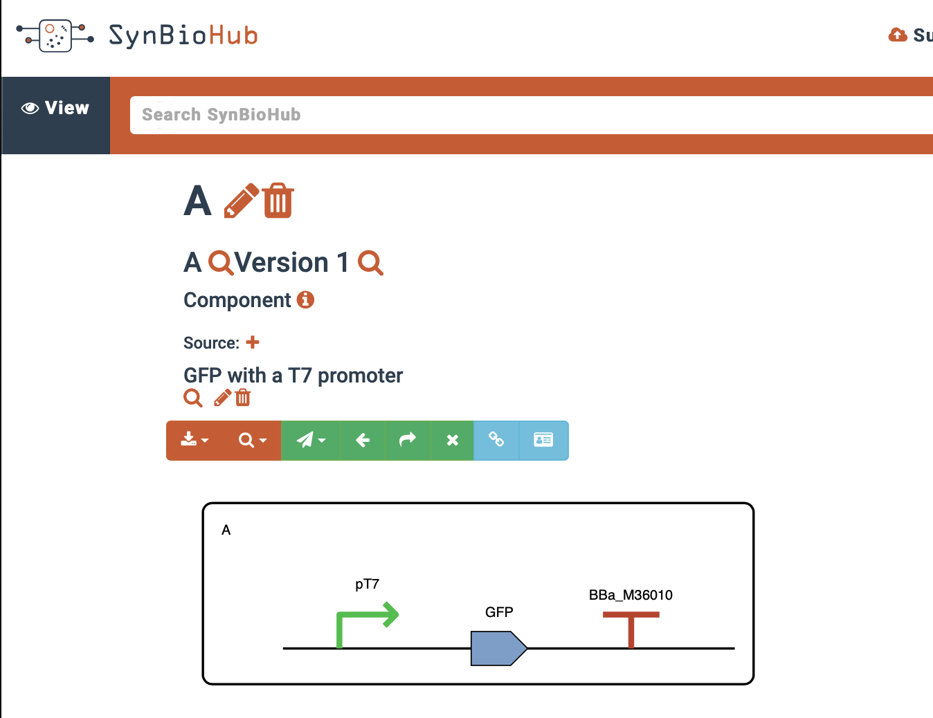
Composite Submission

Slide 12
Achievements
Two plugins
Many functions involved in parsing excel and writing sbol
Filing of several issues related to the new pysbol2 release
Date Time error using iGEM parts
Implementation of advanced query methods
Better tutorial on building composite parts
for Libraries
for Composites

Slide 13
Future Goals
Dockerise plugins
Plugin functionality
Metadata
Incorporate more columns
Subcollections
Greater number of assembly methods (spacers or join regions)
Download Plugin to enable an editing workflow
More templates
Notes:
Further work could also include: incorporating more columns, and sub collections. And you could mention the difficulty/current unclearness of when creating a composite part if any spacers are required or join regions added in and further work might tackle this.

Slide 14


Acknowledgments
My mentors
Jake Beal, Chris Myers and especially Jet Mante
Tom Mitchell from pySBOL2
Google Summer of Code

